Slide 1
NLP on “The Stormlight Archive”
Nick Kinnaird
2/26/21
Find some type of art to put on here
SLA / Cosmere logo?

Slide 2

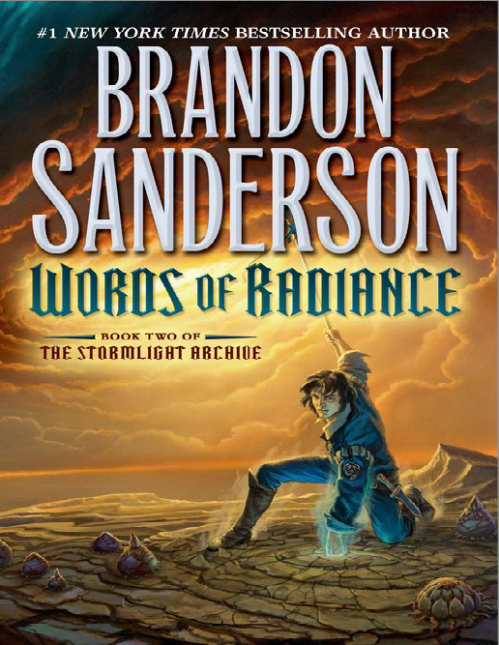
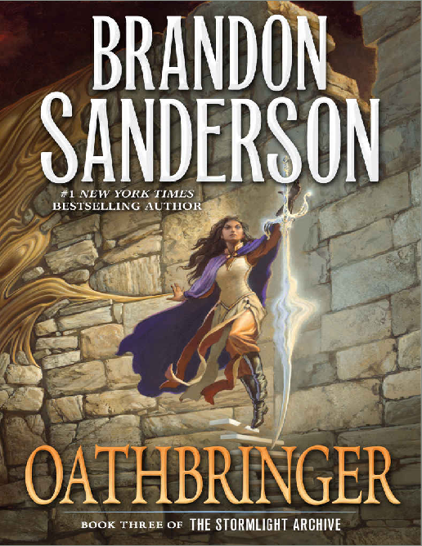

Number of pages and chapters here
Other details

Slide 3
Somehow decide whether to show per page or per chapter results
Should really talk about both, and show some relevant plots for it
First show nmf bar charts
Then tsne plot
Then word clouds
Anything else?? I guess see what the presentation time is looking like after I’ve done that, think about what I can talk about for the characters or whatever
In backup:
Kmeans stuff
Mention about lda
Sentiment analysis stuff
Whatever I don’t show for per page or per chapter results

Slide 4
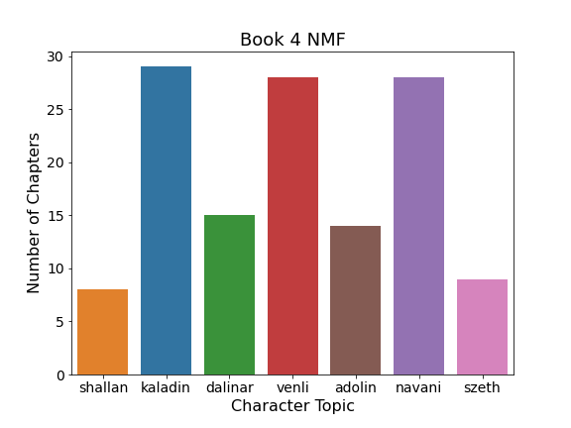
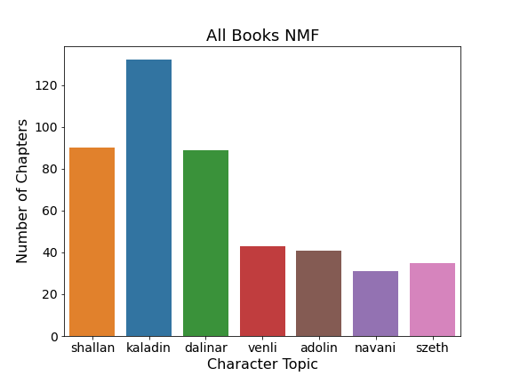
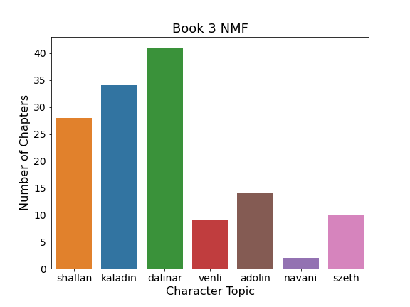
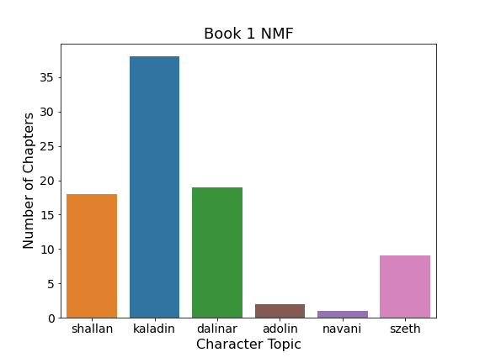
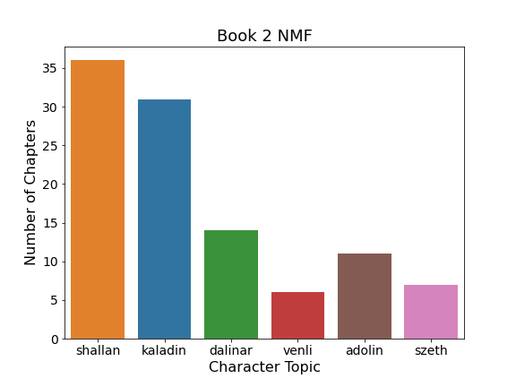

Slide 5
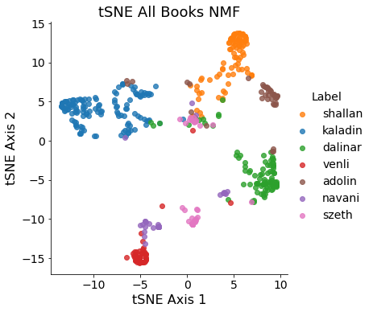

Slide 6
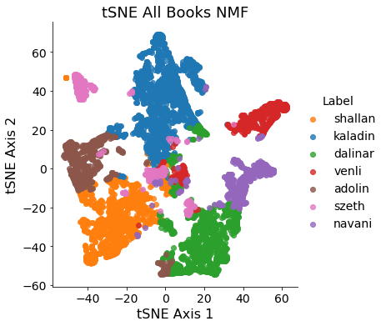
NMF tsne by page

Slide 7
Chapter word clouds
For chapter word clouds maybe show all word clouds for 2 characters, and then just 1 word cloud for the rest of the characters

Slide 8
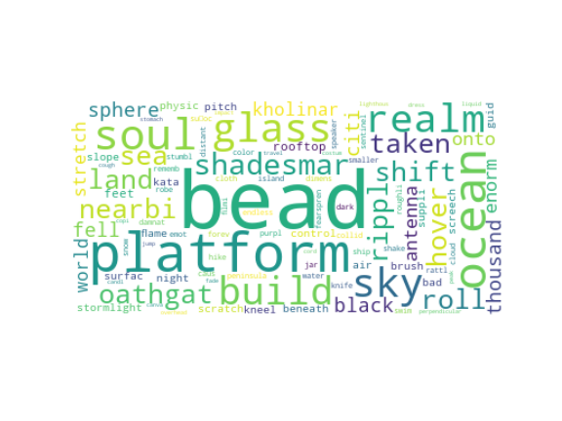
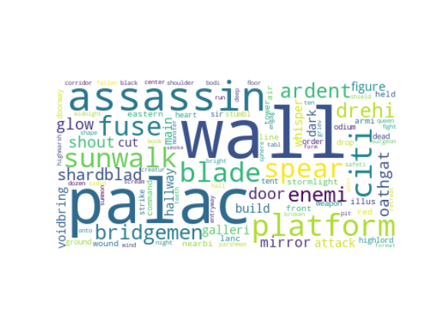
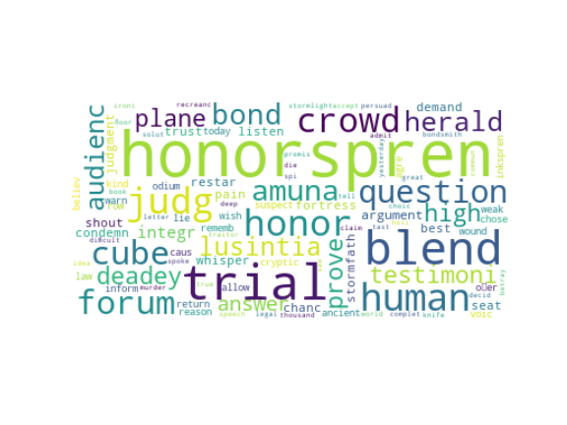
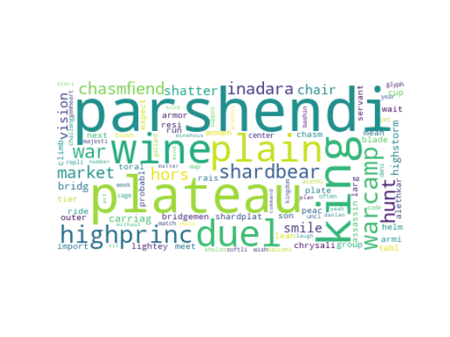
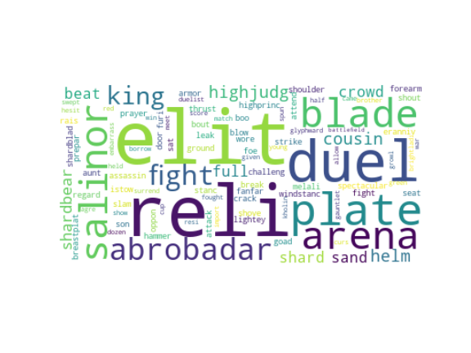
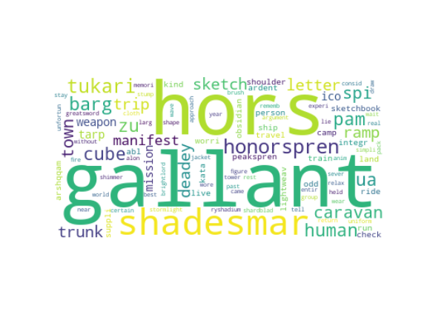
Adolin chapter word clouds

Slide 9
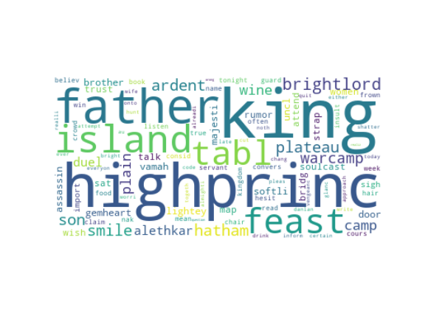
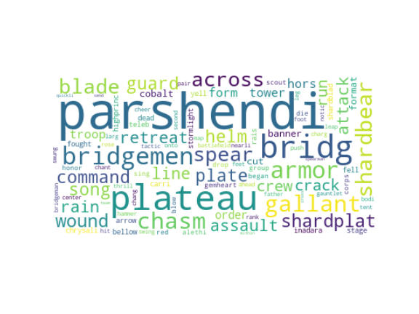
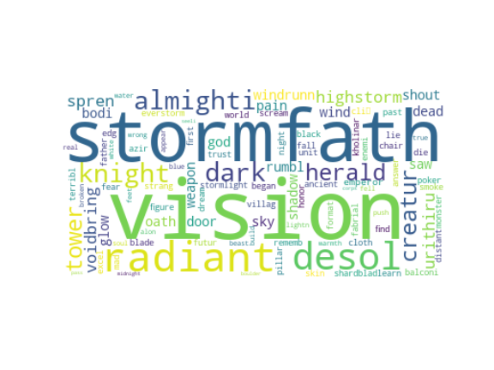
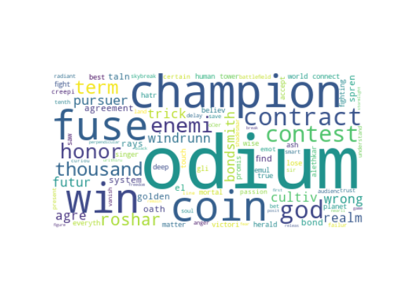
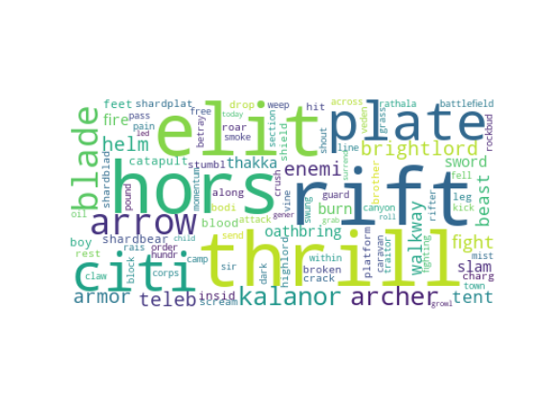
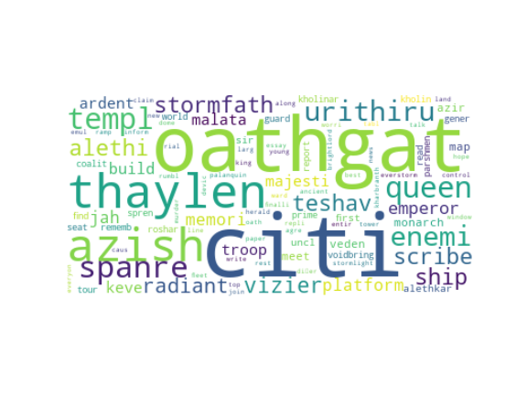
Dalinar chapter word clouds

Slide 10
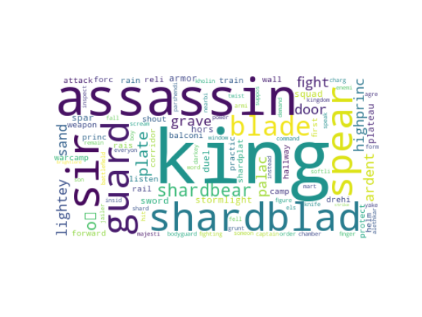
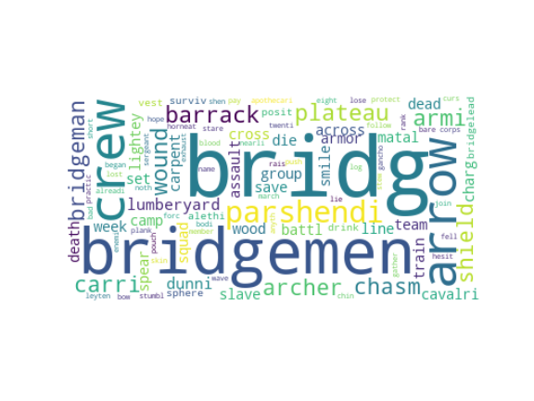
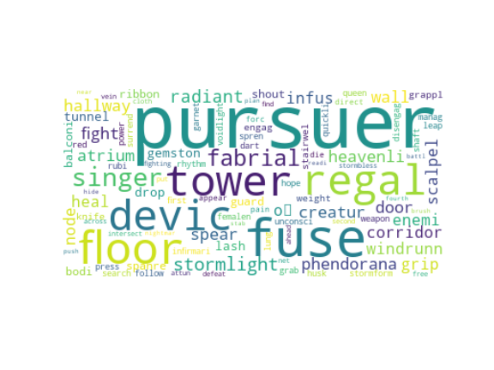
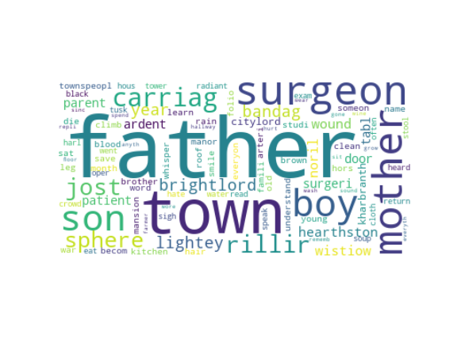
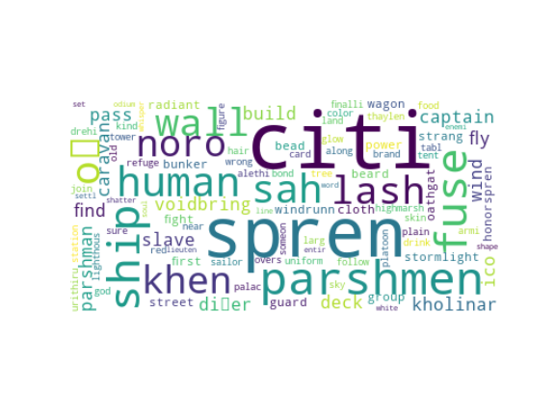
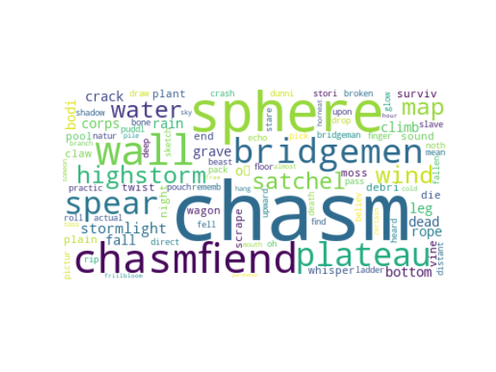
Kaladin chapter word clouds

Slide 11
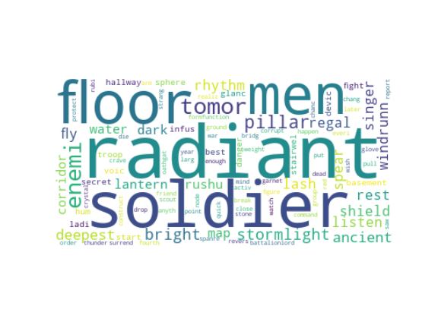
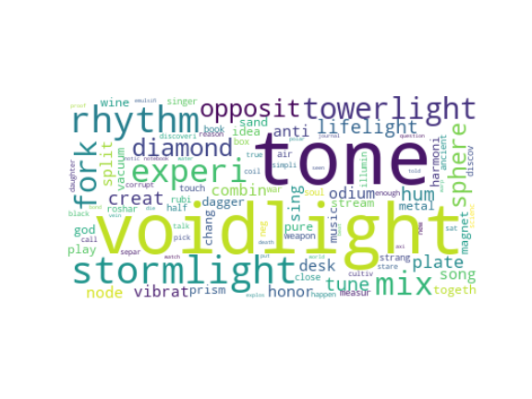
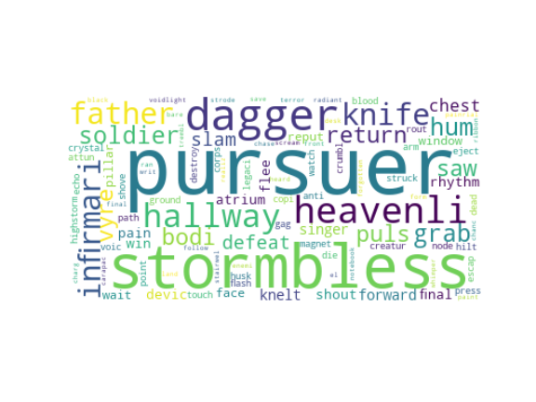
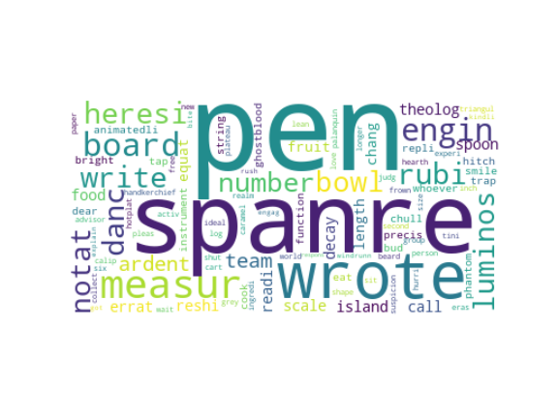
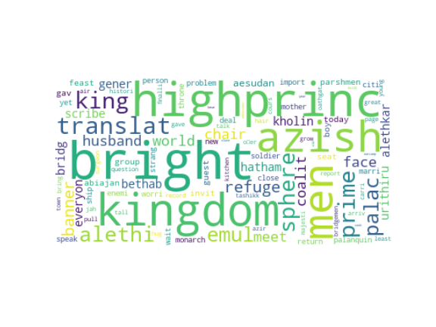
Navani chapter word clouds

Slide 12
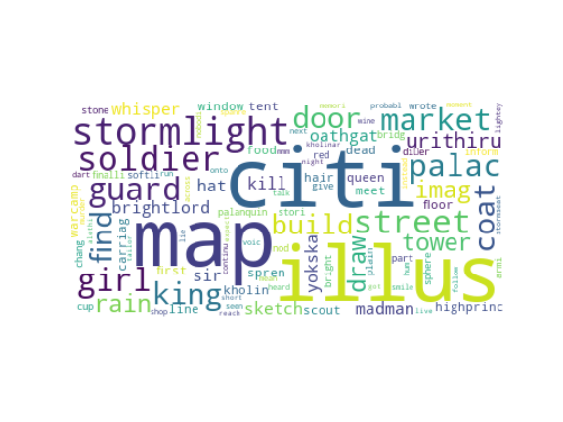
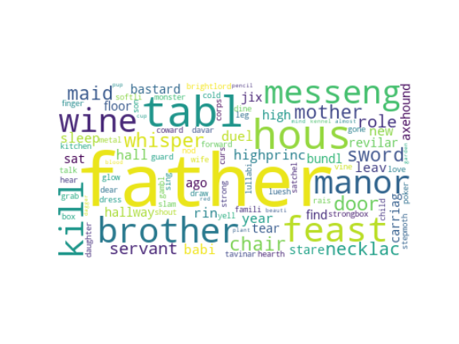
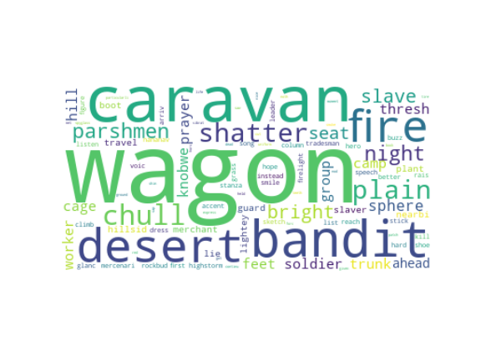
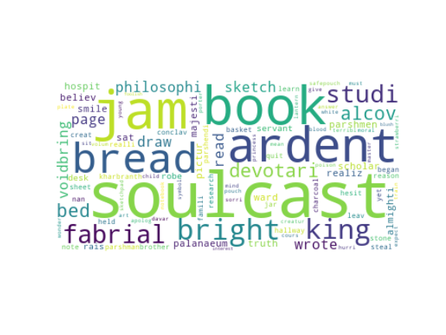
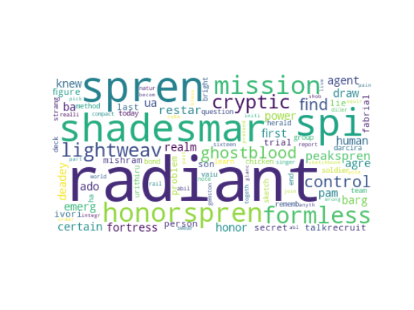
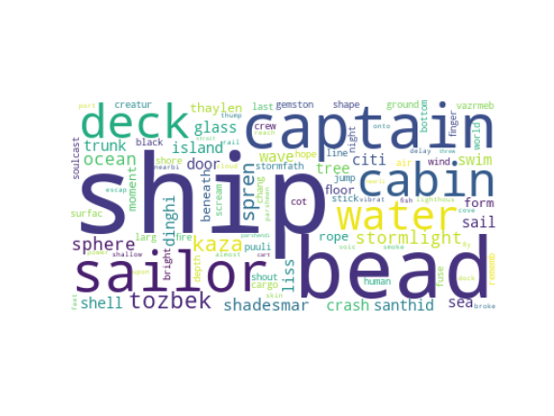
Shallan chapter word clouds

Slide 13
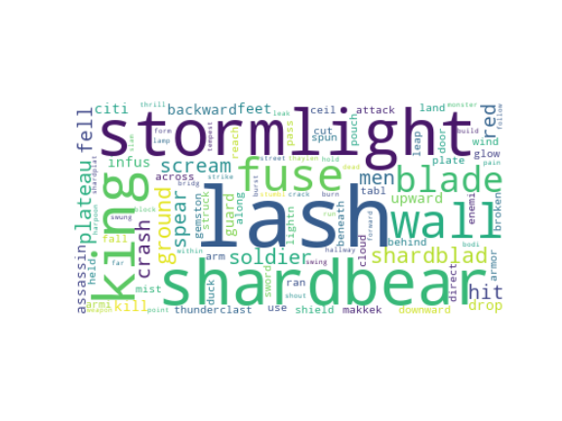
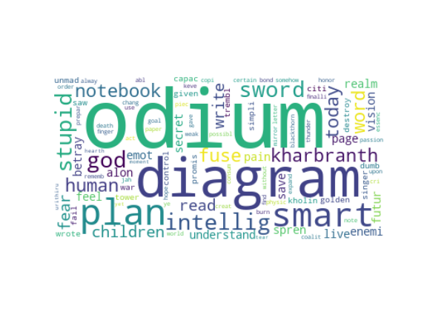
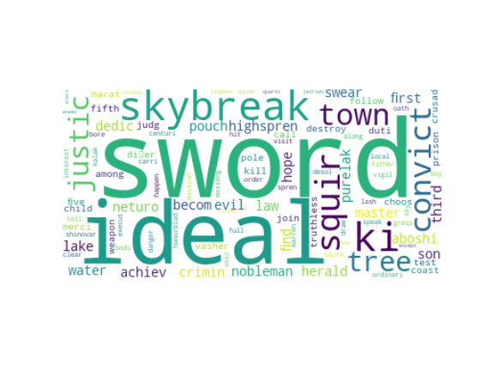
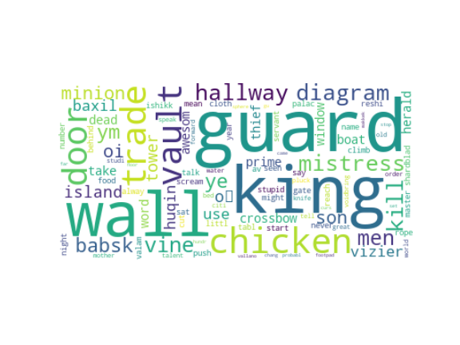
Szeth chapter word clouds

Slide 14
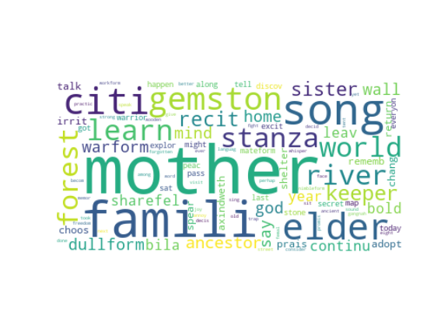
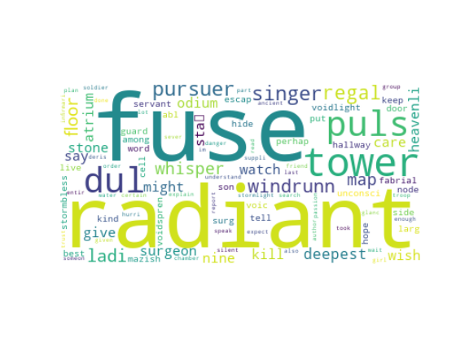
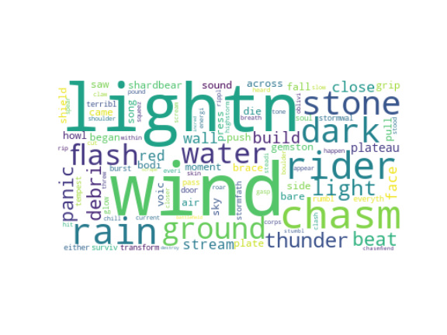
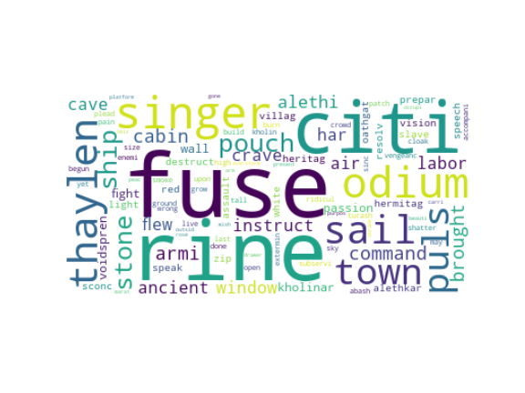
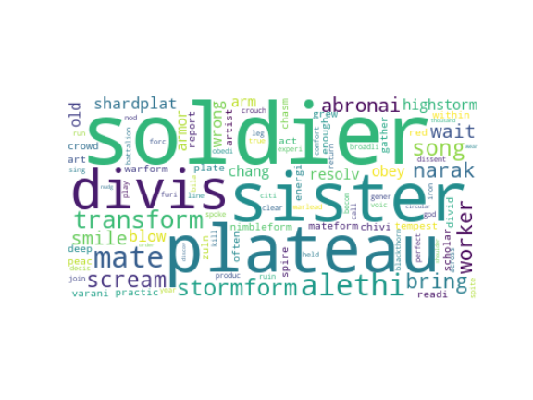
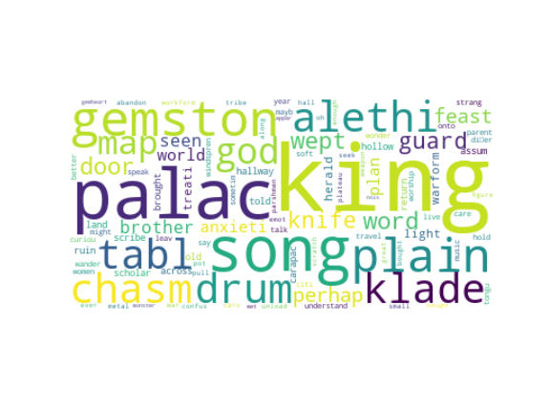
Venli chapter word clouds

Slide 15
Page word clouds

Slide 16
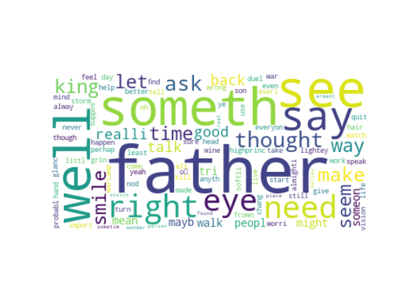
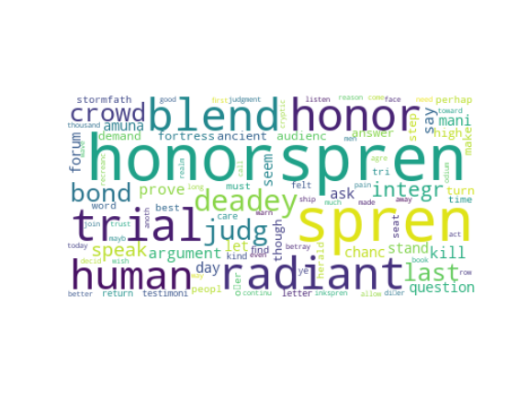





adolin

Slide 17







Dalinar

Slide 18







Kaladin

Slide 19







Navani

Slide 20







Shallan

Slide 21







Szeth

Slide 22







Venli

Slide 23
Trends

Slide 24


Slide 25


Slide 26


Slide 27


Slide 28


Slide 29


Slide 30


Slide 31
Future work
Pare down and focus more specifically on one character
Growth, changes, etc.

Slide 32
Appendix

Slide 33



Slide 34





NMF counts by page

Slide 35







Adolin subtopic trends

Slide 36







Dalinar subtopic trends

Slide 37







Kaladin subtopic trends

Slide 38







Navani subtopic trends

Slide 39







Shallan subtopic trends

Slide 40
Szeth subtopic trends

Slide 41







Venli subtopic trends

Slide 43







Sentiment plots

